Slide 1

COVID-19 CASE STUDY
IST 718 – BIG DATA ANALYTICS
MICHAEL ARMESTO -- PATRICK ASLAKSON – JORDAN SPECTOR

Slide 2
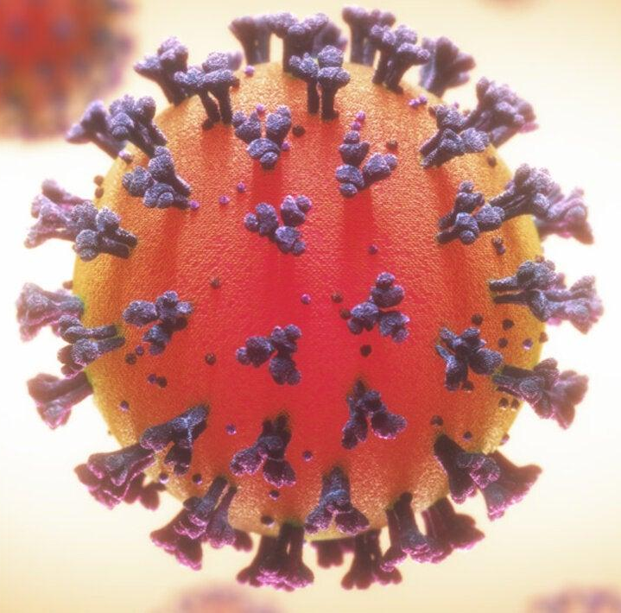
CONCEPT
Our goal is to evaluate the spread of COVID-19 variants on a global scale to better determine the efficacy of the current vaccines and the rate variants spread in areas that utilize masks and encourage vaccination.

Slide 3
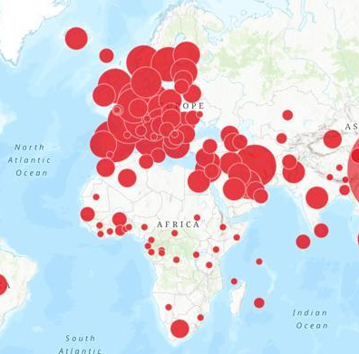
PROBLEM: COVID-19 CONTINUES TO SPREAD THROUGHOUT THE WORLD
201 million cases recorded worldwide
4.27 million deaths reported
Mitigation measures continue to vary per country with no centralized guidance
Lack of clarity around how stringent government-imposed restrictions should be
Variations in mitigation strategies lead to variations in successful prevention
Large numbers of cases increase probability of new variants emerging
Variants threaten vaccine efficacy and natural immunity
Continual necessity for renewing restrictions strains the economy

Slide 4

IMPORTANCE
Identifying most successful preventative measures will help guide decision making around restrictions
Patterns of variant emergence and factors that drive it may help forecast high-risk countries
Can help to plan for future outbreaks by analyzing how recent ones developed

Slide 5
NULL HYPOTHESIS
Ho = Countries who have instituted less mitigation tactics including vaccinations and mask mandates have increased death rates.

Slide 6
OBSERVATION - IN DATA
Parsing issues are the main issue with these large data sets.
The most prevalent issue with the COVID data is that there is a large amount of data. Two of our datasets are so large that they must be broken down into smaller incremental pieces, by country is the current method.
Inconsistencies and inaccuracy in reporting data across different Countries around the globe.
Time Series data was difficult to manage.
Large Datasets were at times unruly

Slide 7
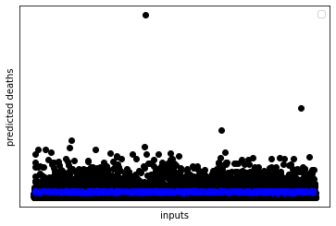
LINEAR REGRESSION - WORLD
Coefficients:
[ 0.32951289 0.04169519 -0.02196575] - facial_coverings - stringency_index - people_fully_vaccinated_per_hundred
Mean squared error: 26.86
Coefficient of determination: 0.03

Slide 8
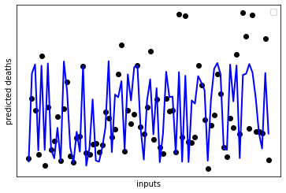
LINEAR REGRESSION – UNITED STATES
Coefficients:
[ 2.34443187 -0.10282321 -0.13333016]
Mean squared error: 4.57
Coefficient of determination: 0.51

Slide 9
STRINGENCY POLICIES
From the University of Oxford
Policies include the following areas of concern on a scale typically from 0 to 5
The specific policy and response categories are coded as follows: School closures Workplace closures Cancel public events Restrictions on gatherings Close public transport Public information campaigns
Stay at home Restrictions on internal movement International travel controls Testing policy Contract tracing Face coverings Vaccination policy

Slide 10
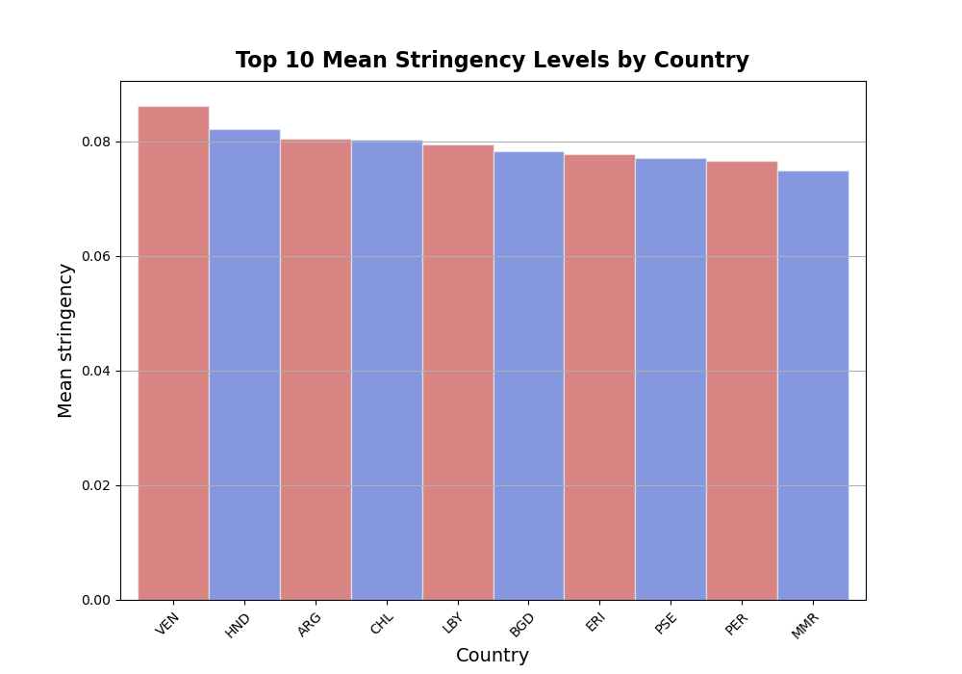
STRINGENCY PLOTS
-.33 correlation between stringency and new cases per million lagged and -.28 between stringency and new deaths per million for top 5 most stringent countries

Slide 11
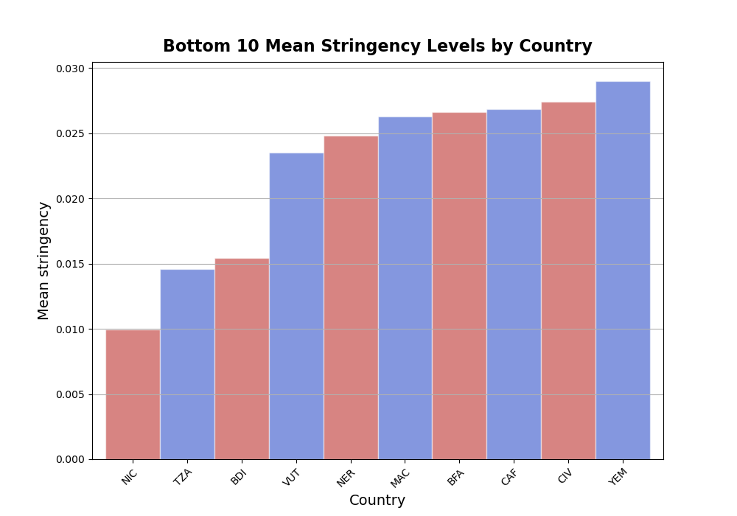
STRINGENCY PLOTS
-.06 between stringency and new cases per million lagged and .02 for new deaths per million for bottom 5 most stringent countries

Slide 12
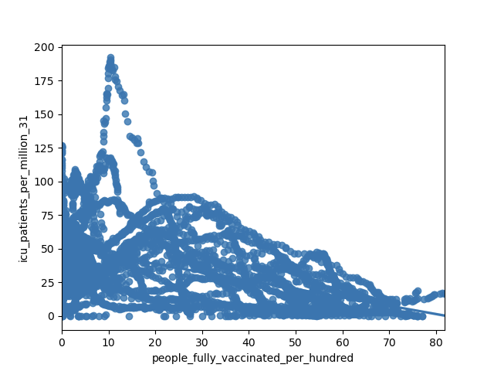
Number of ICU Patients vs. Fully Vaccinated Residents
R = -.47 as more people were fully vaccinate, ICU patients per million on a two-month lag decreased

Slide 13
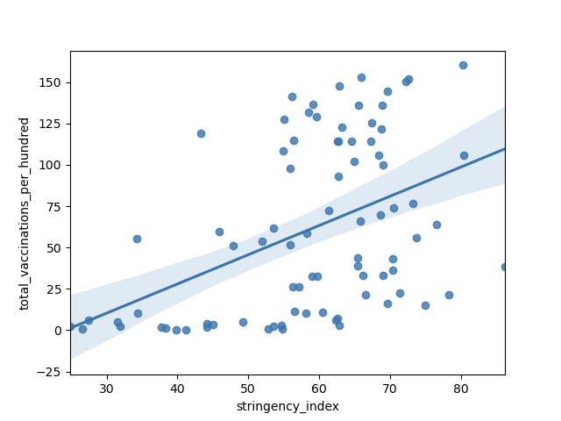
Total vaccinations vs Stringency index

Slide 14
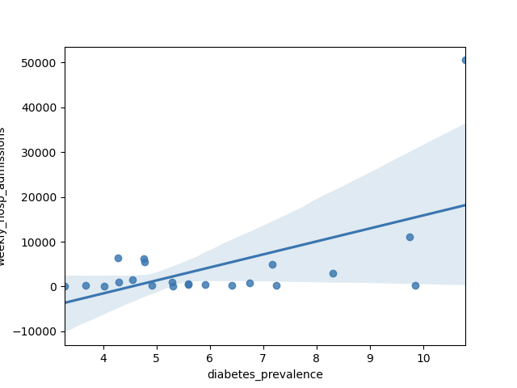
Diabetes Prevalence
r = .56 higher diabetes prevalence on average led to more weekly hospital admissions on average

Slide 15
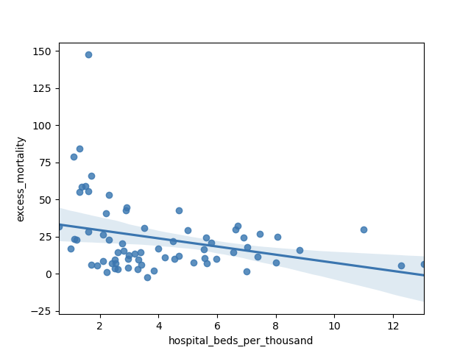
Excess mortality vs. hospital beds per 1000 residents

Slide 16
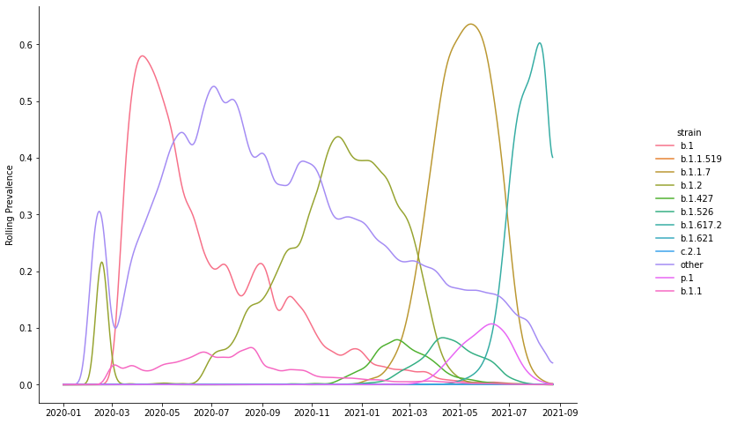
COVID Variants
Prevalence of variants in the United States calculated as a 5-day rolling average

Slide 17
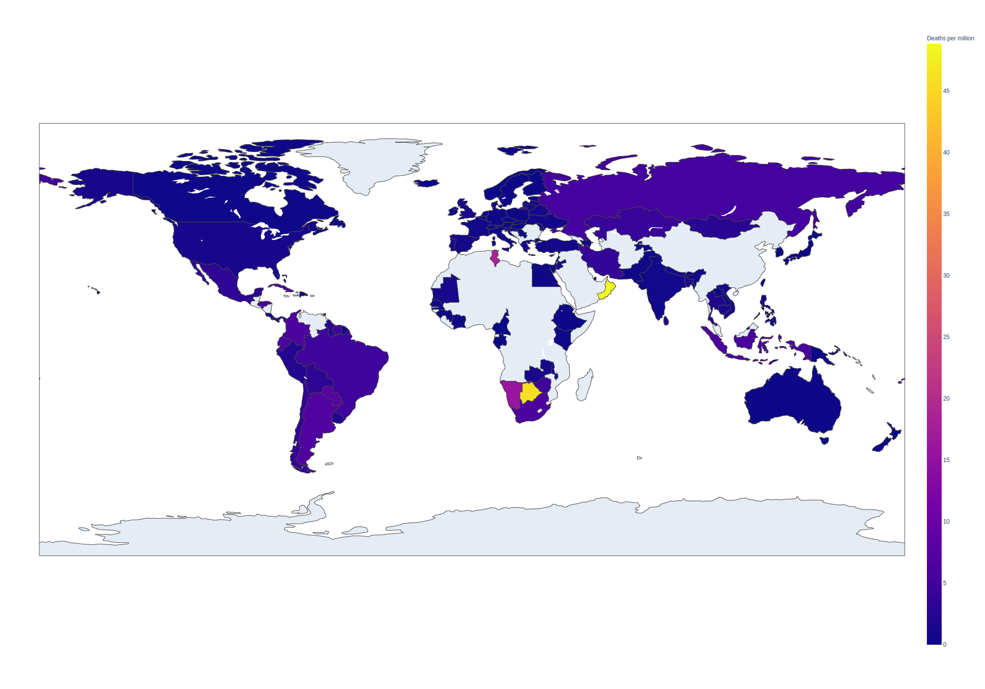
Global COVID Deaths
Daily deaths per million citizens
Weekly average as of August 30, 2021

Slide 18
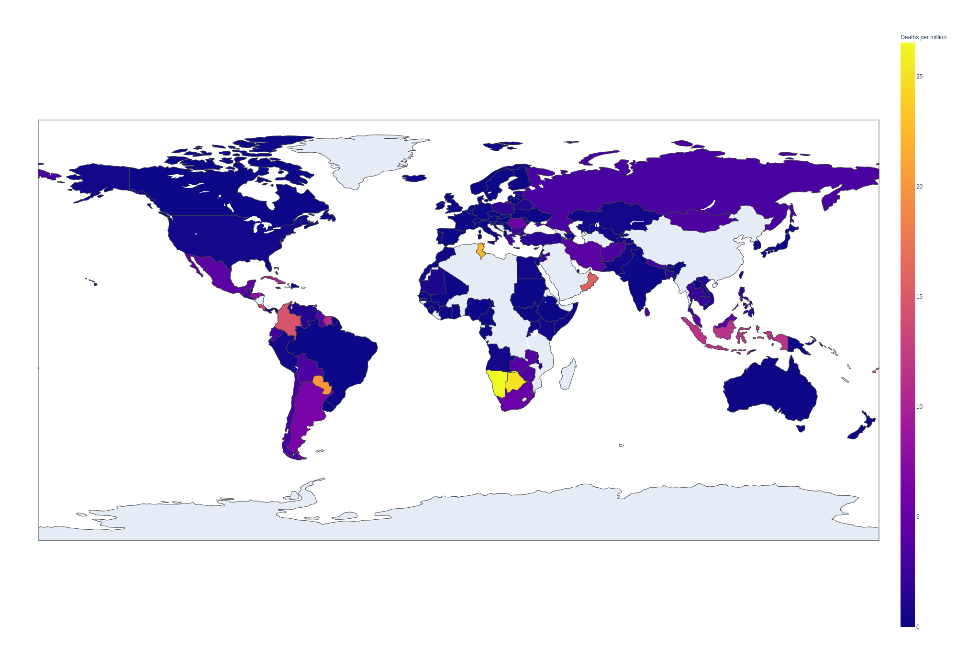
Global COVID Deaths - Forecast
Daily deaths per million citizens
Weekly forecasted average as of November 14, 2021
Forecasted with Facebook’s Prophet using vaccinations and stringency index as regressors

Slide 19
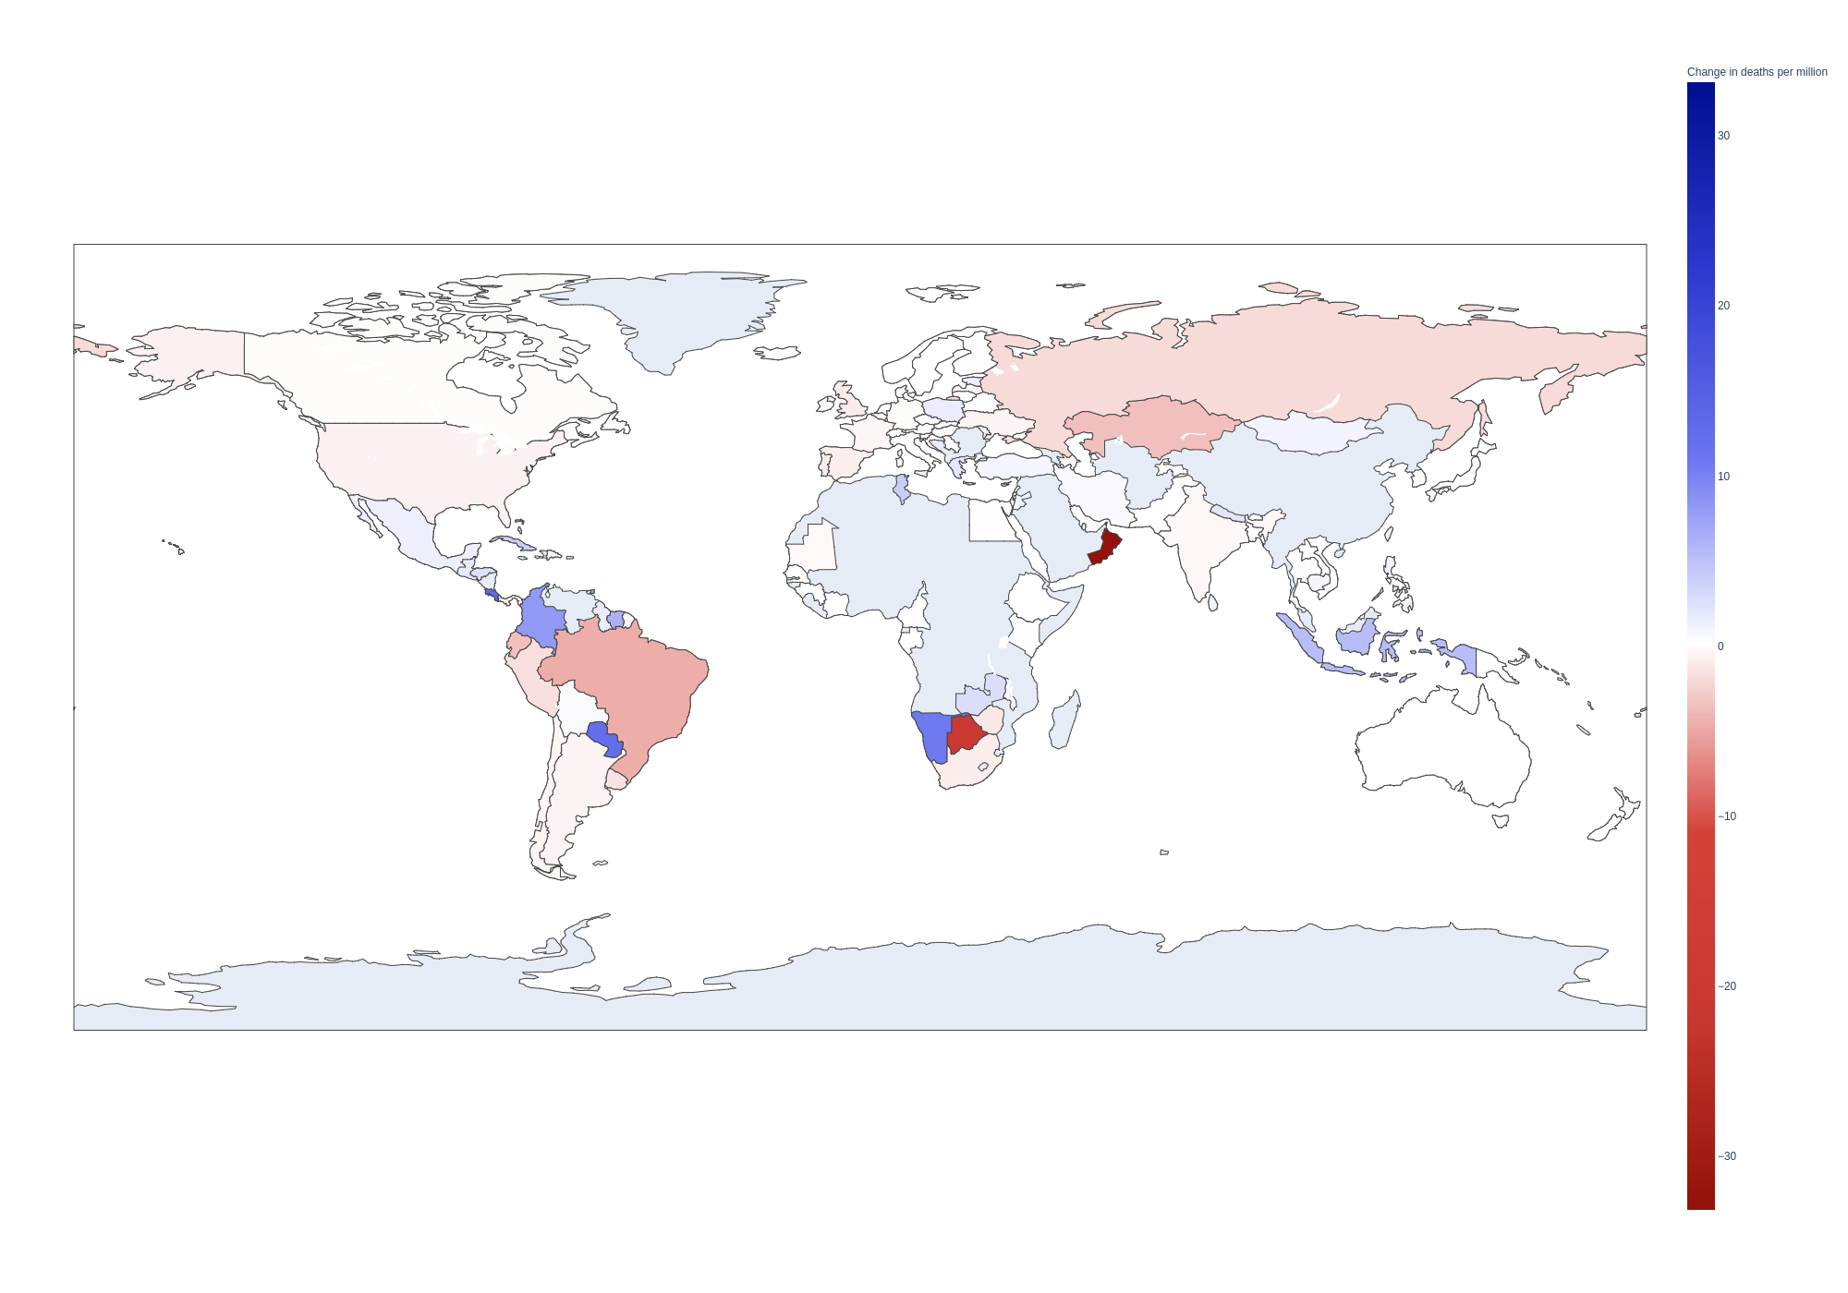
Global COVID Deaths - Forecasted Change
Daily deaths per million citizens
Change in weekly average between August 30 and November 14, 2021

Slide 20
Recommendations
Get vaccinated
Further exploration on the effects of mask mandates, and the implementation of various restrictions such as bar/restaurant closures
Explore further as more data becomes available

Slide 21
QUESTIONS

Slide 22
DATASET SOURCES
https://www.kaggle.com/gpreda/covid-world-vaccination-progress?select=country_vaccinations_by_manufacturer.csv
https://www.nature.com/articles/s41598-021-82873-2
https://www.researchsquare.com/article/rs-434947/v2
https://ourworldindata.org/covid-vaccinations
https://ourworldindata.org/grapher/face-covering-policies-covid
https://github.com/owid/covid-19-data/tree/master/public/data

